Slide 1
CS2422 Assembly Language & System Programming
December 18, 2003

Slide 2
Today’s Topics
Basic Macro Processor Functions
  Macro definition and expansion
  Macro processor tables and logic

Slide 3
Study Guide
Section 4.1

Slide 4
Introduction
Concept
  A macro instruction is a notational convenience for the programmer
  It allows the programmer to write shorthand version of a program (module programming)
  The macro processor replaces each macro invocation with the corresponding sequence of statements (expanding)

Slide 5
Macro Processor
Recognize macro definitions
Save the macro definition
Recognize macro calls
Expand macro calls
Source Code
(with macro)
Macro Processor
Expanded Code
Compiler or Assembler
obj

Slide 6
Macro Definition
Two new assembler directives
  MACRO
  MEND
A pattern or prototype for the macro instruction
  Macro name and parameters

Slide 7
Macro Invocation and Expansion
Often referred to as a macro call
  Need the name of the macro instruction begin invoked and the arguments to be used in expanding the macro
Expanded program
  No macro instruction definitions
  Each macro invocation statement has been expanded into the statements that form the body of the macro, with the arguments from the macro invocation substituted for the parameters in the prototype
Fig. 4.1, Fig. 4.2

Slide 8
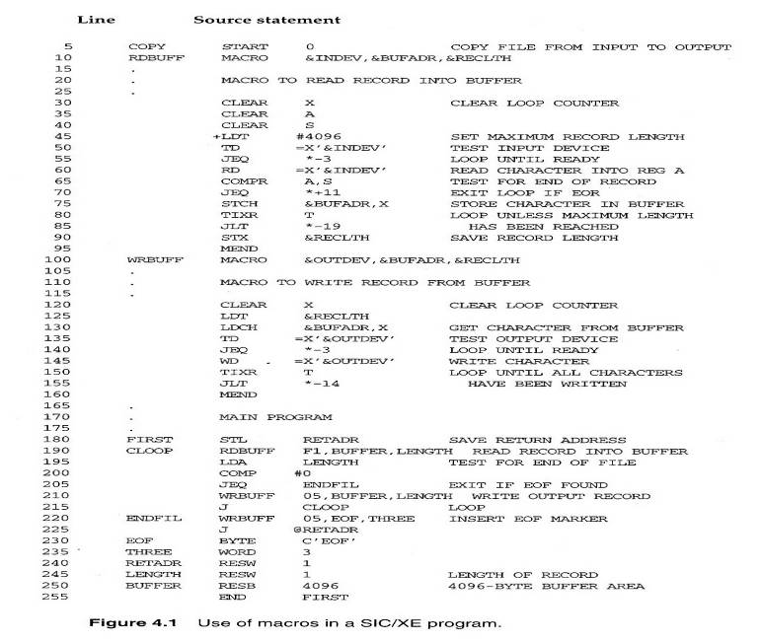
Fig. 4.1

Slide 9
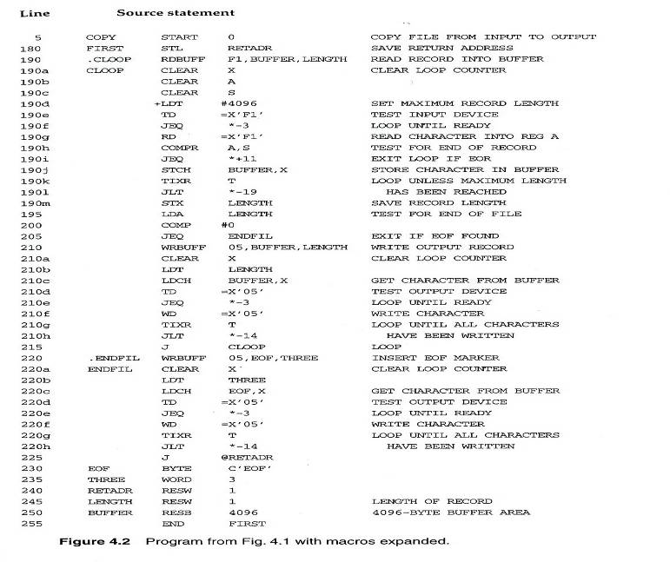
Fig. 4.2

Slide 10
Macro vs. Subroutine
Macro
  The statement of expansion are generated each time the macro are invoked
Subroutine
  The statement in a subroutine appears only once

Slide 11
Macro Processor Algorithm and Data Structures (1/3)
It is easy to design a two-pass macro processor
  Pass 1:
    All macro definitions are processed
  Pass 2:
    All macro invocation statements are expanded
However, a two-pass macro processor would not arrow the body of one macro instruction to contain definitions of other macros
  See Figure 4.3

Slide 12
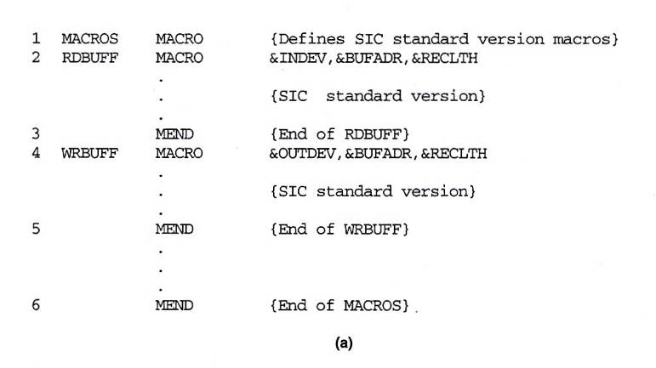
Fig. 4.3(a)

Slide 13
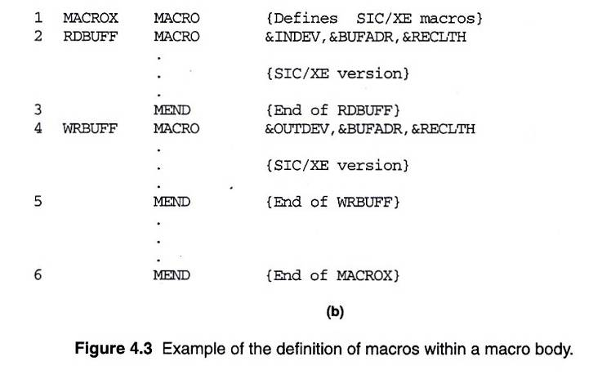
Fig. 4.3(b)

Slide 14
Macro Processor Algorithm and Data Structures (2/3)
Sub-Macro definitions are only processed when an invocation of their Super-Macros are expanded
  See Fig. 4.3: RDBUFF
A one-pass macro processor that can alternate between macro definition and macro expansions able to handle macros like those in Fig. 4.3

Slide 15
Macro Processor Algorithm and Data Structures (3/3)
Because of the one-pass structure, the definition of a macro must appear in the source program before any statements that invoke that macro
Three main data structures involved in an one-pass macro processor (Global variable)
  DEFTAB, NAMTAB, ARGTAB
  Fig. 4.4

Slide 16
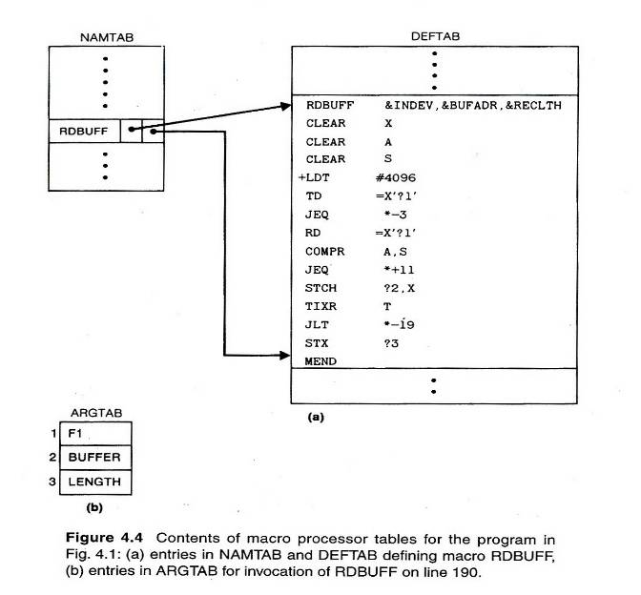
Fig. 4.4

Slide 17
One-Pass Macro Processor
Prerequisite
  Every macro must be defined before it is called
Sub-procedures
  Macro definition: DEFINE
  Macro invocation: EXPAND
MACRO
DEFINE
PROCESSLINE
CALL
EXPAND

Slide 18
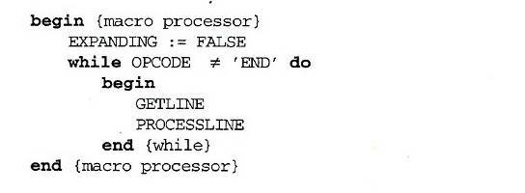
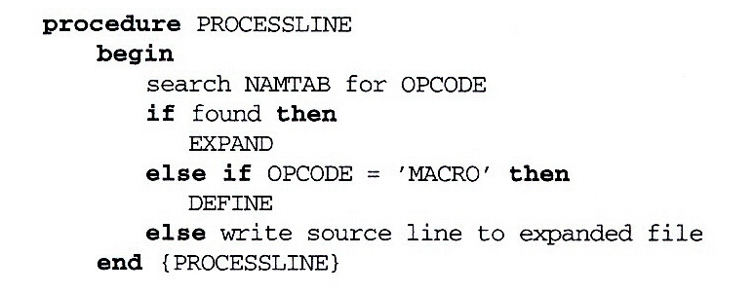
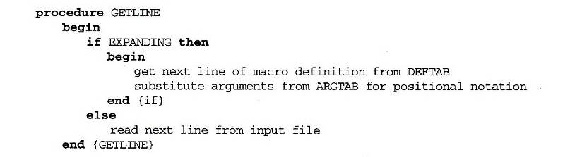
Fig. 4.5 (1/2)

Slide 19
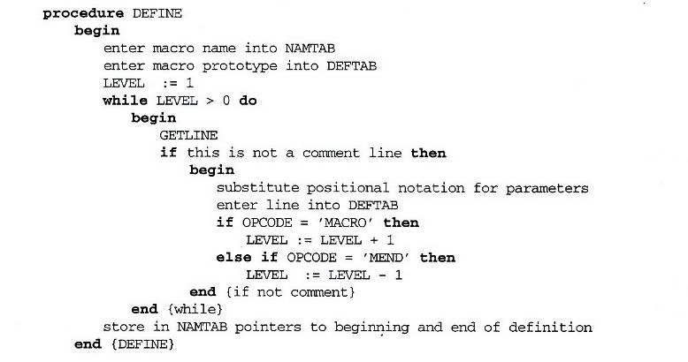
Fig. 4.5 (2/2)

Slide 20
One-Pass Macro Processor That Allows Nested Macro Definition
Sub-procedures
  Macro definition: DEFINE
  Macro invocation: EXPAND
EXPAND may invoke DEFINE when encounter macro definition
NAMTAB
DEFINE
MACRO
DEFTAB
PROCESSLINE
CALL
EXPAND
ARGTAB
Expanding
MACRO Definition

Slide 21
Comparison of Macro Processors Design
Single pass
  Every macro must be defined before it is called
  One-pass processor can alternate between macro definition and macro expansion
  Nested macro definitions may be allowed but nested calls are not
Two pass algorithm
  Pass1: Recognize macro definitions
  Pass2: Recognize macro calls
  Nested macro definitions are not allowed

